Slide 1

KS2 Reading Spine Explained
At Farsley Springbank we choose a selection of texts for Lower KS2 and Upper KS2 which take into account five different ‘plagues’ (types) of text that children need to access in order to become confident readers over time. These are complex in nature and require significant thought above and beyond that of standard children’s fiction.
Archaic: Archaic texts are older texts, those written when authors used different words, in different sequences, within different structures which use cultural references typically over 50 or 100 years old. With each passing year, archaic texts become a little less familiar and a little more distant from the way we write and talk today. A good example of this would be Oliver by Charles Dickens or Hamlet by Shakespeare. Teachers and parents can help prepare their students for archaic texts by encouraging them to read extracts or whole texts.
Non-Linear: Nonlinear texts challenge a reader’s expectation that time elapses in an even, straightforward manner. These texts force readers to contend with confusing moments when time, or the rate at which it appears to be passing, shifts suddenly and without explanation. Storytelling, in short, doesn’t obey any rules in terms of how time elapses. Teachers and parents can help prepare students for these narratives by training them to spot time shifts and re-reading texts to help understand them.
Narratively Complex: A text’s narrative voice can add to its complexity. It can have multiple narrators, non-human narrators (for example Varjak Paw or Black Beauty), or even unreliable and deceitful narrators. The challenge that such a book poses should not be underestimated: these texts are tricky and can result in failed misunderstanding of the characters or the story as a whole. Teachers and parents can help new readers by familiarising them with all different kinds of narrators early on in their reading journey. This keeps them from getting disoriented and discouraged when they encounter unreliable or multiple narrators as their reading becomes more complex
Symbolic: Complex stories are confusing, even for advanced readers, as they force the reader to hold a story together even as different plotlines swerve off in different directions. To prepare students to read successfully, teachers and parents must expose children to texts with complex plot structures. Making sense of contradicting plots requires deep analysis of a text. Teachers and parents should be very clear and rigorous about untangling the plot.
Resistant: When authors write resistant texts, they mean for the material to be difficult to understand (for example poetry). Often with these texts, gaps in meaning are part of the journey towards understanding. Reading resistant texts is a huge challenge—but an important one. Three key actions can help teachers and parents prepare students to read resistant text successfully: exposure to dense texts, reading poetry and reading shorter examples (such as some picture books).

Slide 2


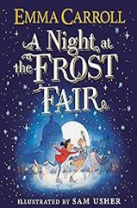
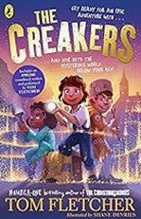
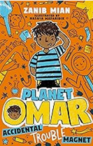
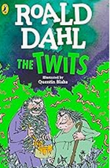

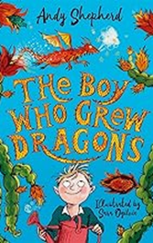
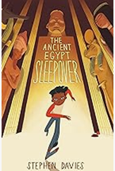
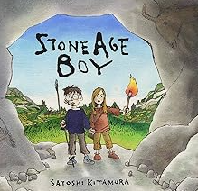
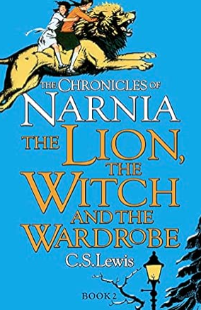
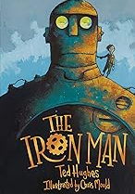
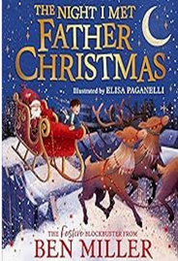
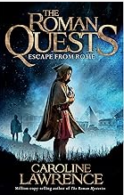

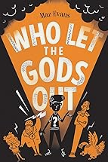
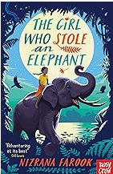
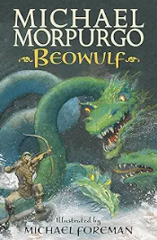
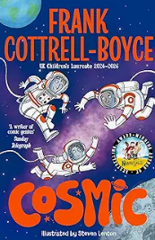









KS2 Reading Spine
 | Archaic | Non-Linear | Narratively Complex | Symbolic | Resistant
Year 3
Year 4
Year 5
Year 6

