Slide 1
Times Table Games
Multiples Slam – write down 6 of your chosen times table on a whiteboard, partner does the same. Race to rub out your board by rolling the nice for a factor and then multiplying that by your chosen times table. First to rub out wins.
Four in a row– to put a cross in your chosen circle you need to say the answer to the times table question. First to get 4 in a row wins.
Spider web – player 1 rolls the dice and fills in the amount of gaps with the multiples of their chosen times table, player 2 does the same with theirs (choose different times tables) Whoever finishes the web first wins.
Spider legs – choose your times table, write the multiples in the circles on the edges of the paper, you have to roll the dice to the right factor to times by your chosen times table to draw a spiders leg to the circle.
Times Table Race – rock, paper, scissors for whoever is going first. First person starts to fill in the grid whilst the next person tries to roll a double, when they do the first player hands the pen over and second player starts filling theirs in whilst the third player tries to roll a double, once someone has filled their table then the game is over.
Crocodile – Take turns calling out coordinates on the 6×6 grid, aiming to reveal the hidden answers without stumbling upon the crocodiles. The Question Master, using the 3×6 grid corresponding to the caller’s turn, reads the question at the specified coordinate. For example, if the caller selects A4 and the question is 7×7, the answer should be correctly placed in that square.Players must strategically navigate the grids, filling in answers while dodging the perilous crocodiles. The game intensifies as players race against each other, trying not to be the first to uncover all three cunning crocodiles. https://www.youtube.com/watch?v=VZfAK14uORI
6. Ladder – to move up the ladder, you have to roll a multiple of the number stated. First to the top wins.

Slide 2
Four in a Row
x | 2 | 3 | 4 | 5 | 6 | 7 | 8
9
10
11
12
3
4

Slide 3
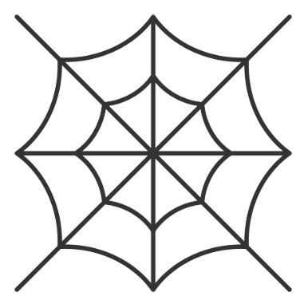
Spider Web

Slide 4
Times Table:
Spider Legs

Slide 5
x | 3 | 4 | 6
3
4
5
6
7
8
9
11
12
Times Table Race

Slide 6
6
5
4
3
2
1
A
B
C
Crocodile

Slide 7
6
5
4
3
2
1
A
B
C
Crocodile

Slide 8
6
5
4
3
2
1
A
B
C
D
E
F
Crocodile

Slide 9

Multiple of 8
Multiple of 7
Multiple of 6
Multiple of 5
Multiple of 4
Multiple of 3
Ladder

